Slide 1


Speech Emotion Recognition
Team Members: Team Name: Three Adams
Vinay Tahiliani
Dheeraj Kumar Sundar
Neil Patel

Slide 2

Introduction
Speech Emotion Recognition, or SER, involves identifying human emotions and emotional states by analyzing speech patterns. This is based on the idea that voice can convey underlying emotions through variations in tone and pitch. Animals like dogs and horses also rely on this phenomenon to understand human emotions.

Slide 3
Dataset
Crowd-sourced Emotional Mutimodal Actors Dataset (Crema-D)
Ryerson Audio-Visual Database of Emotional Speech and Song (Ravdess)
Surrey Audio-Visual Expressed Emotion (Savee)
Toronto emotional speech set (Tess)
We use the combination of these 4 datasets. They are being created by collecting the recordings of actors performing various emotional expressions and they are being labelled accordingly in their metadata.

Slide 4

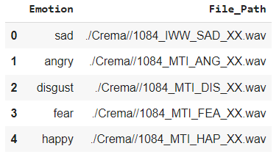
Glimpse of the data
Anger
Disgust
Fear
Happy
Neutral
Sad

Slide 5
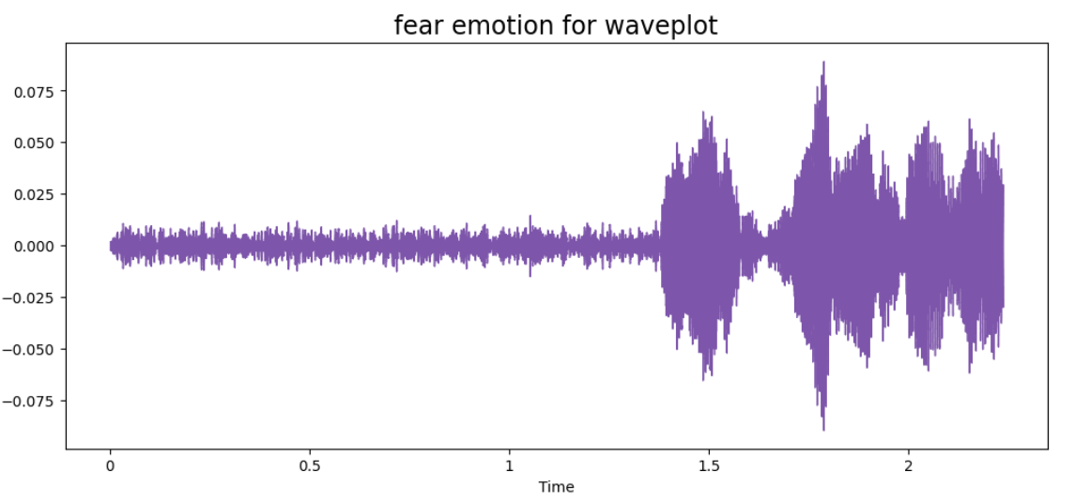
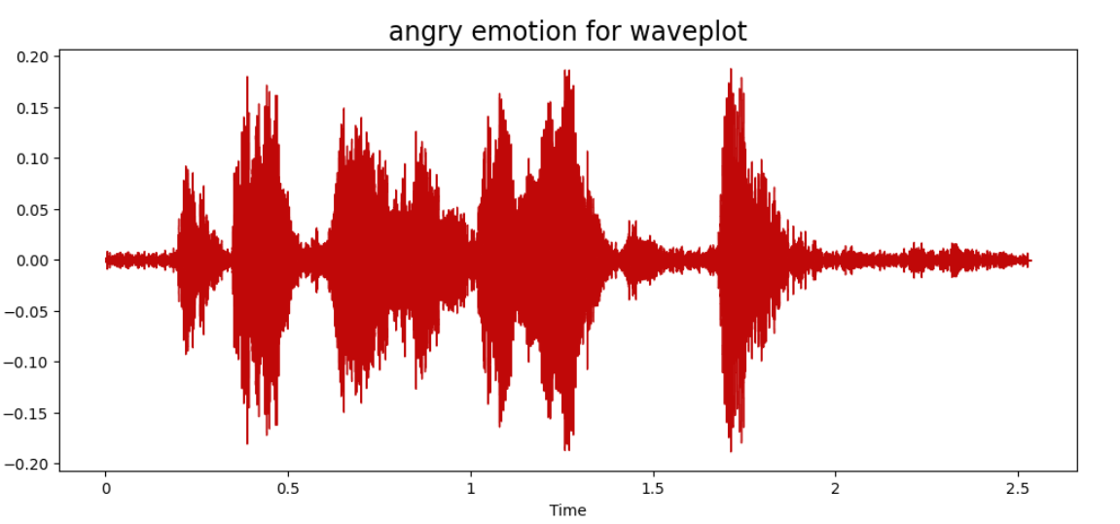
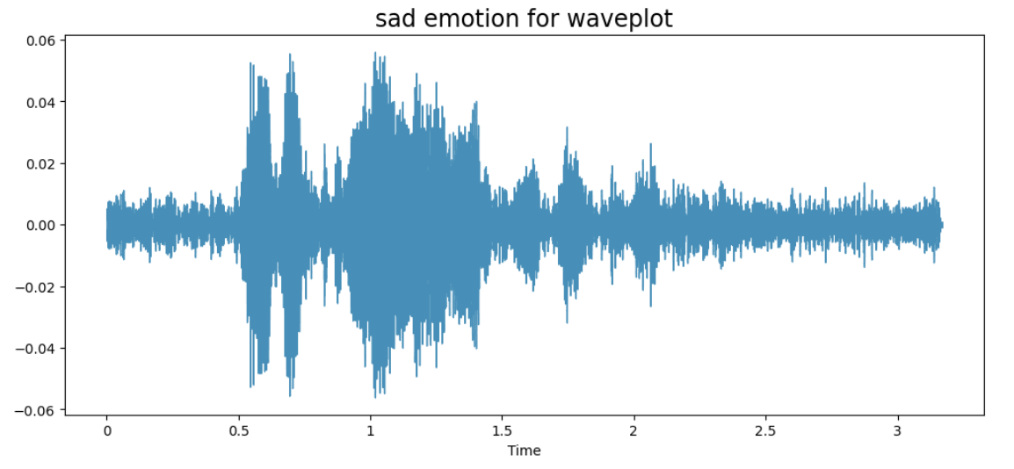
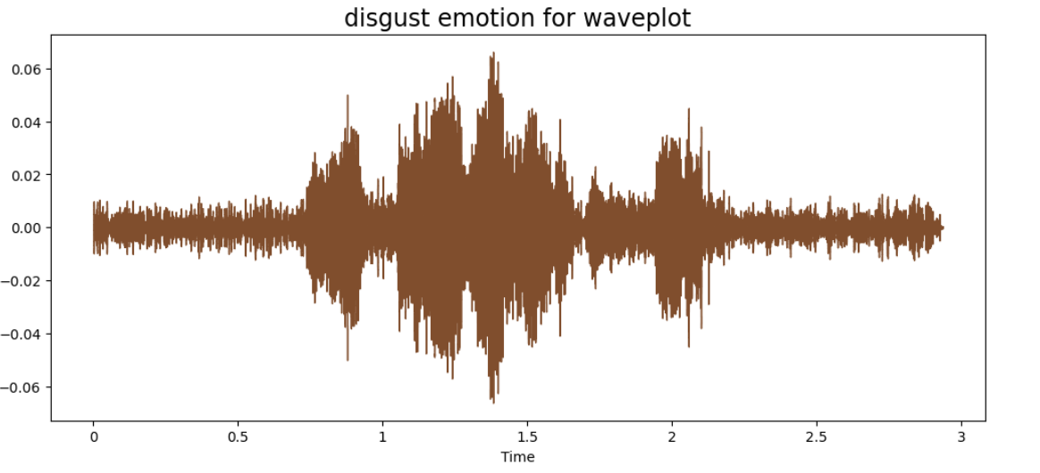
EDA of Audio

Slide 6
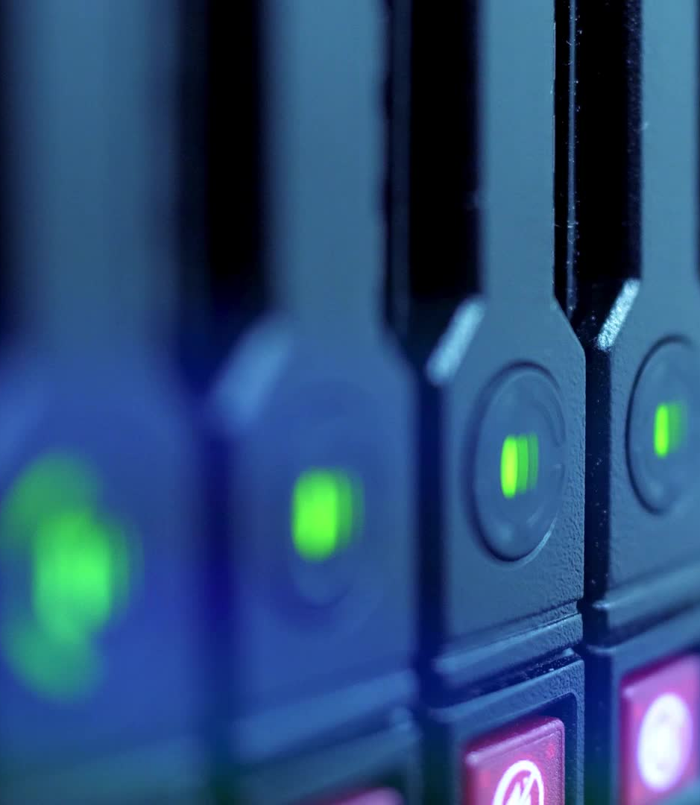
Data Augmentation
Data augmentation is a technique that involves generating additional training data by making minor modifications to the original dataset. To create artificial data for audio, we can add noise, alter the timing, modify the pitch and adjust the speed.
We have made use of librosa package to augment our data
We converted the data into an array and after that added noise and pitch to it.
Objective: The objective is to make our model invariant to those perturbations and enhance its ability to generalize.

Slide 7
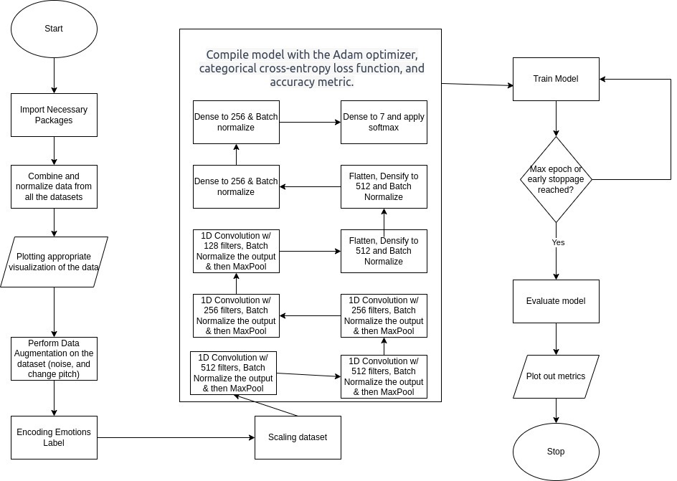
Model Architecture

Slide 8
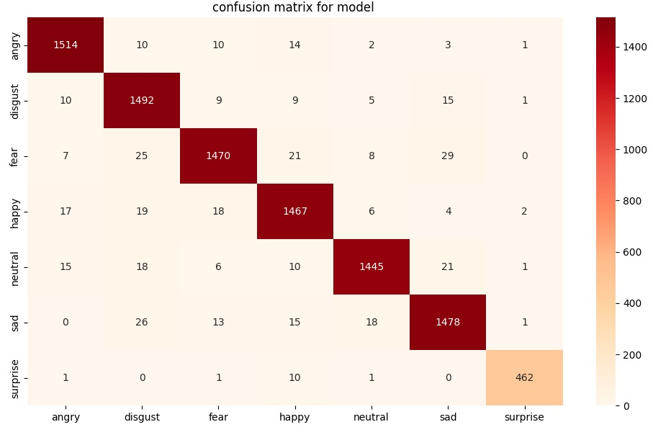
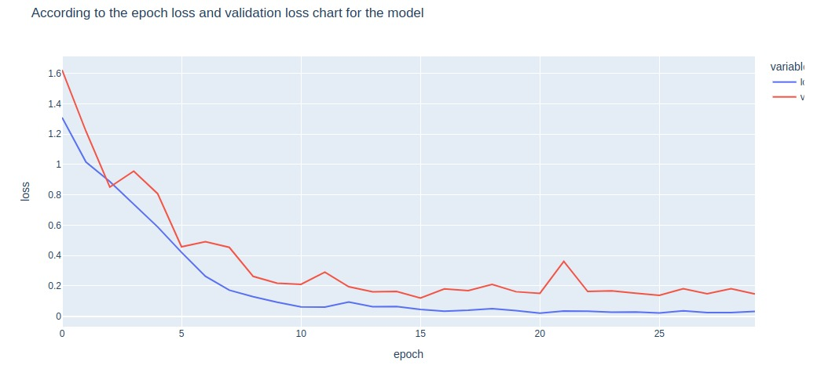
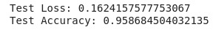
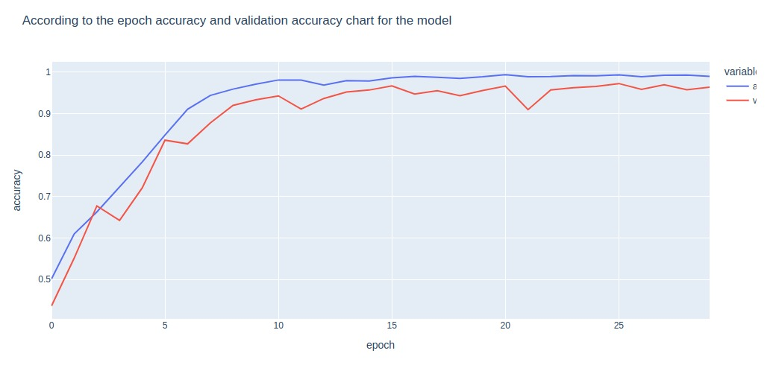
Results

Slide 9

Roles
Vinay Tahiliani: Responsible for feature engineering, which involves implementing various techniques to extract relevant features from the speech signals that could be used to classify different emotions.
Neil Navneet Patel: Responsible for data preparation, which involves collecting and curating a large dataset of speech signals that are labelled with different emotions. This is done as the dataset needs to be diverse and well-balanced to ensure the model’s generalization ability.
Dheeraj Kumar Sundar: Responsible for model creation, which involves designing and training a CNN model that will take the extracted features and maps them to the corresponding emotions. hyperparameter tuning is used to get the best results. Also responsible for the Python script which will use the trained model and classify live recordings(Used in demonstration).

Slide 10

Implementation Difficulties
People might interpret emotions differently because they are subjective. Emotions are a difficult concept to define.
It's hard to annotate an audio recording. Should we annotate an entire conversation, a single word, or a sentence? How many different emotions should we be able to identify?
Data collection is difficult. The news or movies can provide a wealth of audio information. However, because news reporting must be objective and actors' emotions are imitated, both of them are biased. Finding unbiased, impartial audio recordings is difficult.
Data labelling is very time and work-intensive. It takes skilled professionals to listen to the entire audio recording, analyze it, and provide an annotation, as opposed to just laying the boundaries on an image. Due to the subjectivity of the annotation outcome, numerous people have to analyze it.

Slide 11
Methods For Improvement
After feature engineering, we were able to extract meaningful features from the audio signal. For this project, we have used the ZCR (Zero-crossing rate), RMS (Root mean square), and MFCC (Mel frequency cepstral coefficients).
Data augmentation technique to increase the size of the dataset and to make the model generalize better for new test data.
Finally, we implemented a CNN model with multiple layers, to learn from the extracted features and to classify the emotions in the audio signals. This allowed the model to learn more complex patterns in the dataset and improve its accuracy to recognize the emotion from a person’s speech

Slide 12
Discussion and conclusion
The most important step in speech emotion identification is feature engineering, which aids in the extraction of pertinent information from unprocessed audio data. ZCR, RMS, and MFCC are a few of the features that are often used for this task.
Another technique for enhancing the model's performance is data augmentation. We can improve the robustness of the model and minimize overfitting by extracting a wider range of samples from currently available data.
The model performed well, with an overall accuracy of 95%.

Slide 13
Citations
Audio signal Processing for Machine Learning
CNN for Audio Classification
Audio Feature Extraction
Dataset

Slide 14

Thank you

